Slide 1

Intro to Linux
and OSS
Lecture 1
btorres, trinityc
Notes:
Btorres

Slide 2
Topics today
Course logistics
Intro to the shell
What is UNIX?
Free and Open Source Software
Notes:
Btorres

Slide 3
Logistics
Lab01 and Vitamin01 released and due Saturday, 9/9
You should have access to Ed and Gradescope
Let us know if you do not!
Lecture slides, recording, and lab will all be posted at decal.ocf.io
Notes:
btorres

Slide 4
Engaging with this lecture
Connect to the shell (follow along!)
ssh $OCF_USERNAME@ssh.ocf.berkeley.edu
I’ll do a demo in a minute!
Ask questions!
During live sessions
On #decal-general
Notes:
btorres

Slide 5
Shell
What is the shell? A command line-interface (CLI) to interact with the computer.
Common shells: bash, zsh, fish
They’re mostly the same, (bash will be supported by almost all UNIX systems though).
Notes:
trinity

Slide 6
Shell Commands
Basic structure of a command is `[command] [flags] [arguments]`
RTFM! `man (command)`
Google is also your best friend.
Notes:
trinity

Slide 7
Common Shell Commands
`cd` - change directory
`ls` - list directory
`cat` - concatenate and print files
`head` - read the first 10 lines
`less` - read larger files
`mv` - move
`cp` - copy
`rm` - delete a file

Slide 8
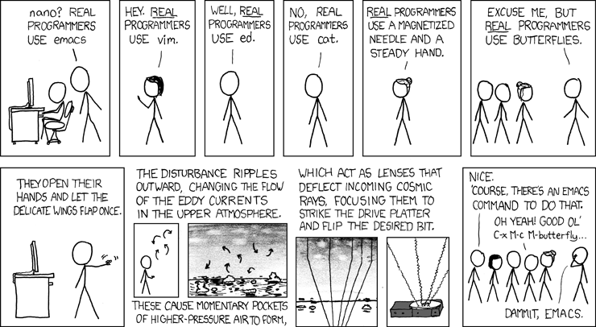
Editors
Nano
Vim (`vimtutor`)
Emacs (Emacs Tutorial)
Try running `(editor of choice) (file)
Try searching “vi” or “emacs” on google
Notes:
btorres

Slide 9
Demo

Slide 10
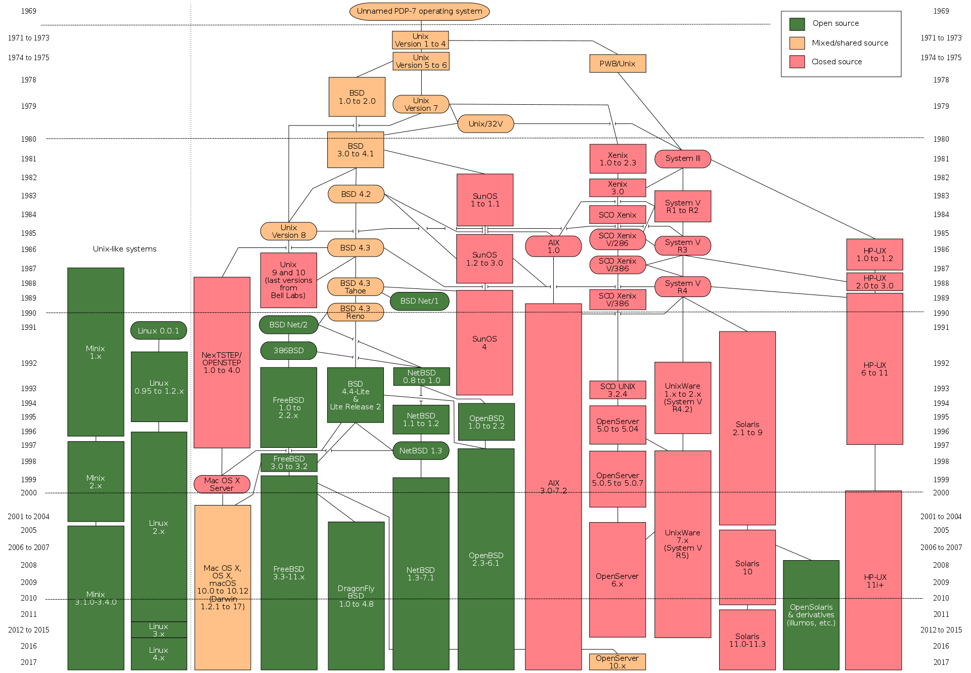
Evolution of UNIX

Slide 11
Open Source Software (OSS)
Free and Open Source Software (FOSS) or Free/Libre Open Source Software (F/LOSS)
“Free as in beer, and free as in freedom”
Open source software - term used by some software and technology companies. You may not have the right to use, modify, or redistribute the software or source code.

Slide 12
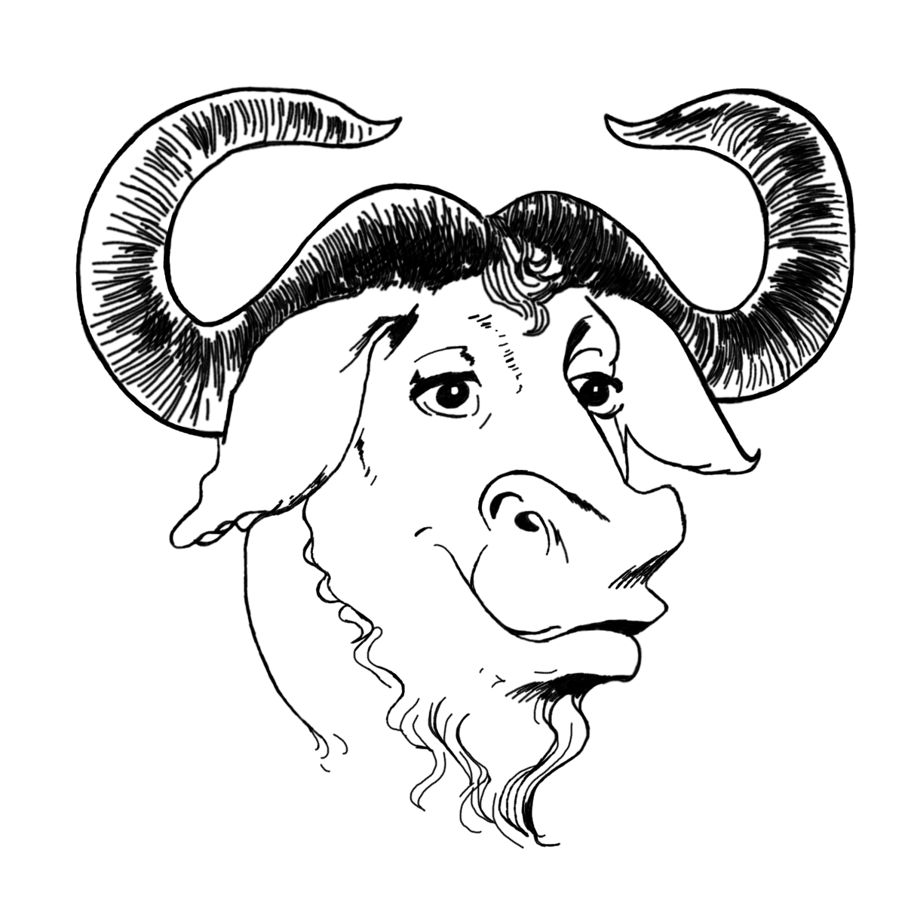
GNU and the Free Software Movement
“So that I can continue to use computers without violating my principles, I have decided to put together a sufficient body of free software so that I will be able to get along without any software that is not free.”
Richard Stallman (1983)
https://groups.google.com/forum/#!msg/net.unix-wizards/8twfRPM79u0/1xlglzrWrU0J

Slide 13
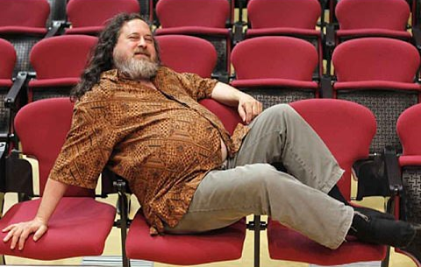
GNU and the Free Software Movement
“So that I can continue to use computers without violating my principles, I have decided to put together a sufficient body of free software so that I will be able to get along without any software that is not free.”
Richard Stallman (1983)
https://groups.google.com/forum/#!msg/net.unix-wizards/8twfRPM79u0/1xlglzrWrU0J

Slide 14
The Four Freedoms
The freedom to run the program as you wish, for any purpose.
The freedom to study how the program works, and change it so it does your computing as you wish. Access to the source code is a precondition for this.
The freedom to redistribute copies so you can help others.
The freedom to distribute copies of your modified versions to others. By doing this you can give the whole community a chance to benefit from your changes. Access to the source code is a precondition for this.
What is free software? by the Free Software Foundation

Slide 15

Berkeley Standard Distribution
A UNIX derivative (BSD) was created at UC Berkeley
Popular and reliable, a lot of things from BSD are used today
vi and Berkeley sockets
Stuck in legal limbo w/ AT&T
BSD derivatives still remain popular (MacOS, FreeBSD, OpenBSD)

Slide 16
Unix’s advantages over non-Unix systems
UNIX philosophy: simple, short, clear, and modular code
UNIX idea: “everything is a file”
Worse is better.
Sockets for networking, now copied beyond Unix systems
“It’s very simple — you read the protocol and write the code.” - Bill Joy on implementing TCP/IP
Notes:
E.g. `whoami`
E.g., devices and processes are treated as files (security concept)
https://en.wikipedia.org/wiki/Worse_is_better

Slide 17













Why FOSS?
Security
Cost
Privacy
Control
Collaboration
Notes:
Security by obscurity bad, but vuln are often overlooked.
Re privacy, irc vs messenger/discord

Slide 18
OSS Licenses: Legal Jiggery-Pokery
Copyleft (GPL)
“I want to make sure that all versions of GNU remain free.” - Stallman (GNU Manifesto)
“a cancer that attaches itself in an intellectual property sense to everything it touches” - Steve Ballmer
Permissive (MIT, BSD, Apache, WTFPL)
Do whatever you want (basically)
choosealicense.com/licenses
Notes:
Spend ~10s on this

Slide 19
(even more) Demo

Slide 20
Additional Resources
Resources on learning:
How to ask good questions by Julia Evans
How to teach yourself hard things by Julia Evans
Technical resources:
ArchWiki (“If the ArchWiki offered dating advice, no Linux user would be single." - Ex-SM of the OCF)
The Linux System Administrator's Guide from The Linux Documentation Project
The Debian Administrator’s Handbook by Raphaël Hertzog and Roland Mas
Fun reads about UNIX history and culture:
In the Beginning was the Command Line by Neal Stephenson
About the GNU Project by the Free Software Foundation
Philosophy of the GNU Project by the Free Software Foundation
GOOGLE.COM

Slide 21
(even more)*2 Demo

